Slide 1





z
z
Project overview
We developed an intelligent ordering and delivery system integrating deep learning and robotics. A Flask-based web interface combined voice recognition connects customers and vendors. 3D-printed products are recognized using yolo, grasped by a robotic arm, and delivered via autonomous vehicles. In general, deep learning powers object recognition, while robotics handles automated pick-and-deliver operations.
-

Slide 2
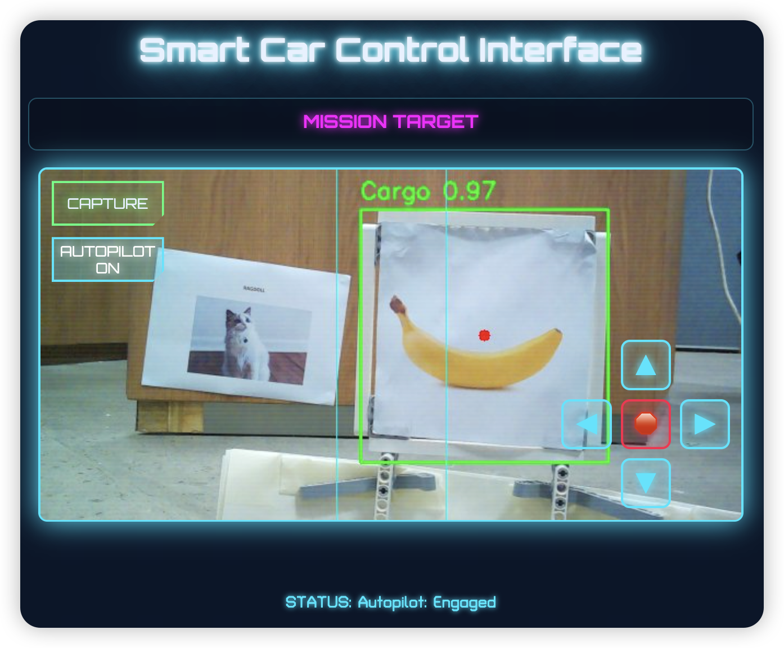
z
z
Path Planning Program Relying Solely On Vision
YOLO model to draws recognition boxes of the cargo
Red dot to control the direction of movement.

Slide 3
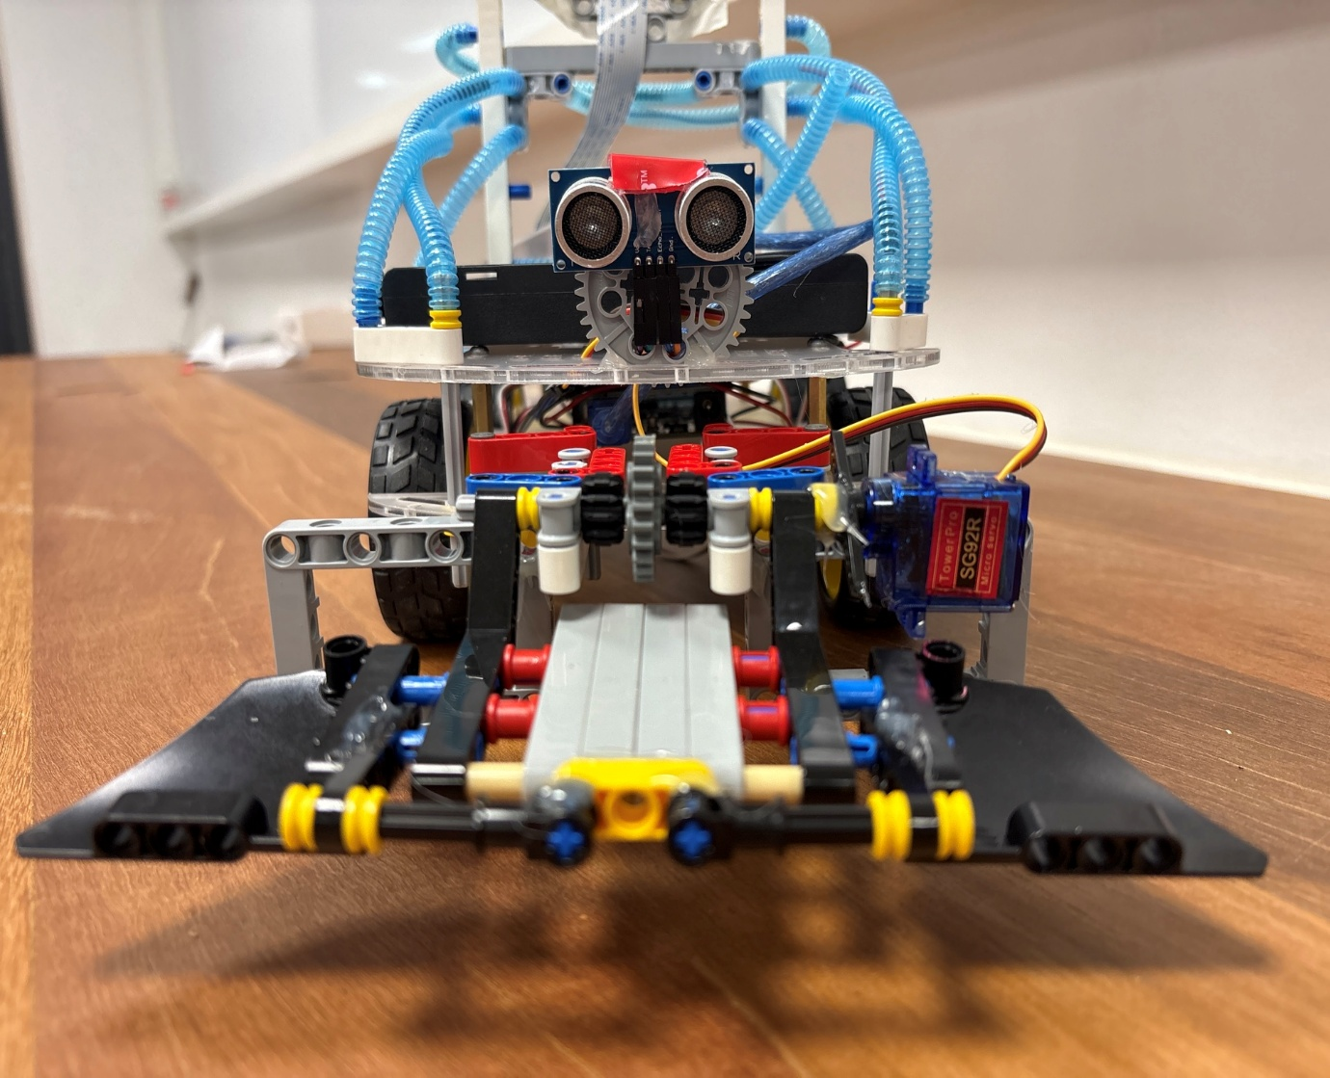


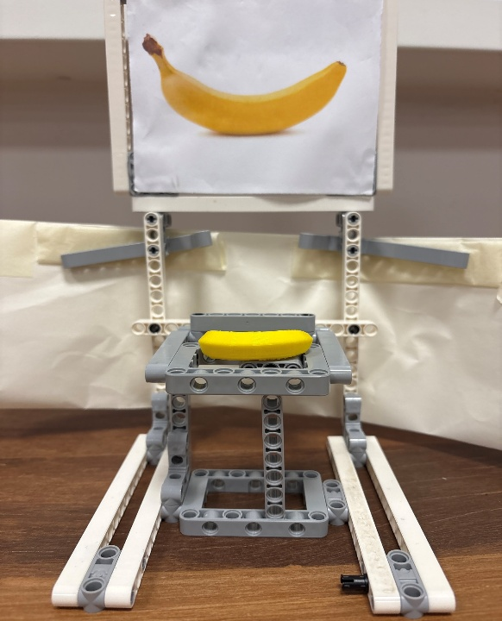
Ultrasonic Sensing And Mechanical Arm
Once the car approaches the goods, it will stop moving and wave its mechanical arm.
The arm knocks down the support, causing the goods to fall into the robotic arm.

Slide 4

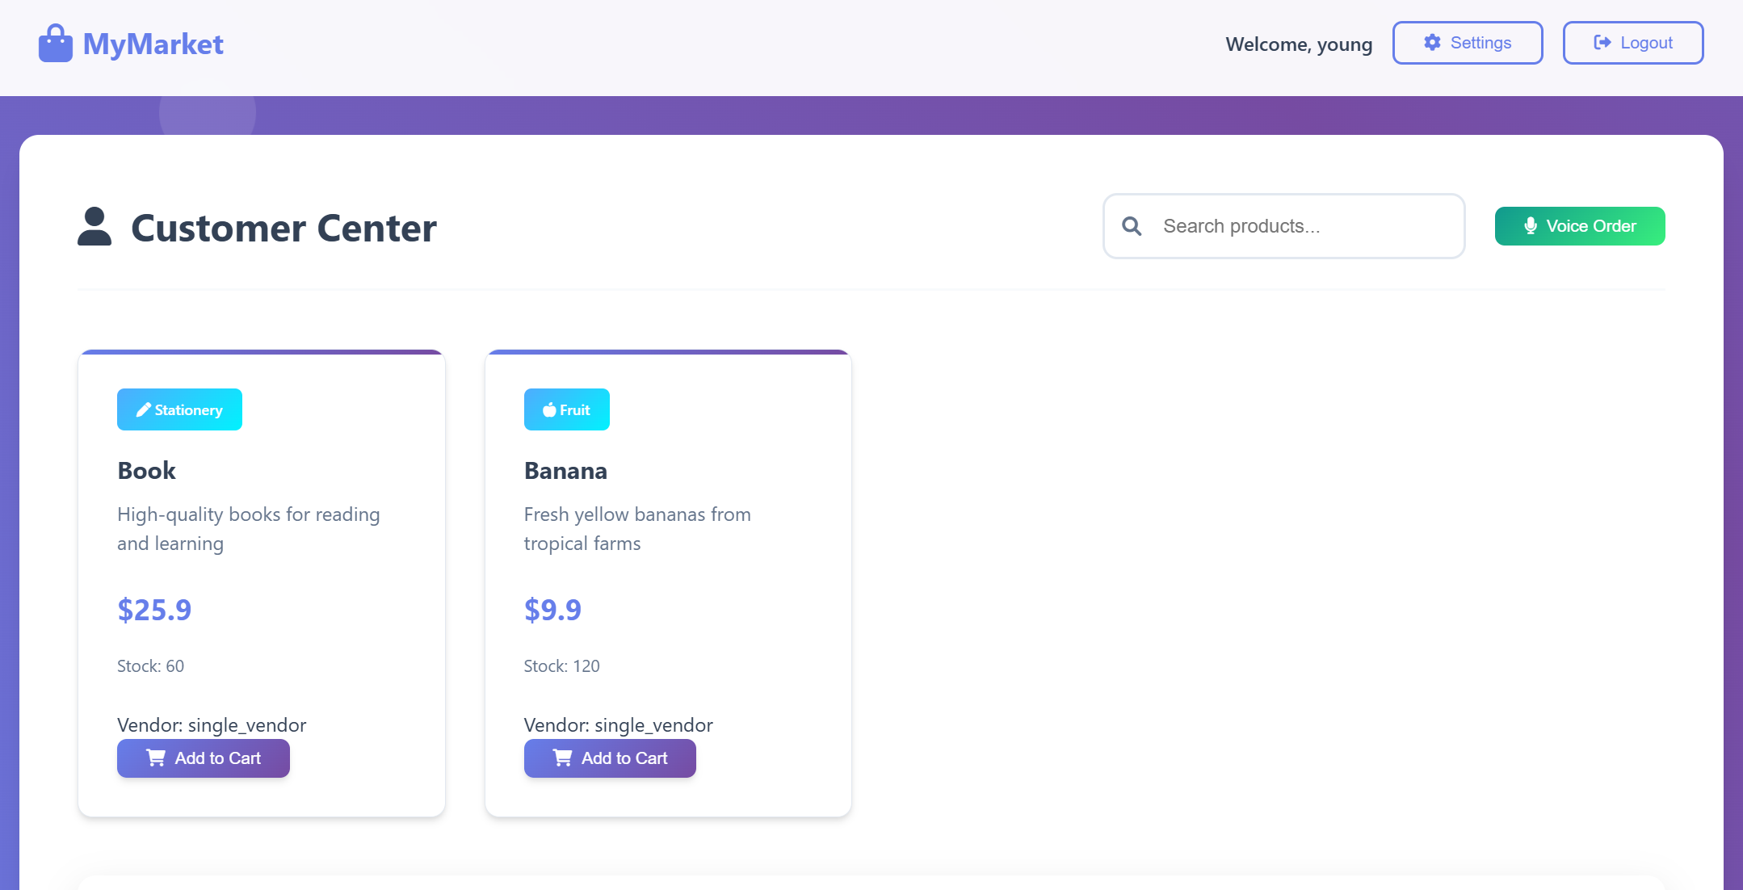
z
z
Customer /Vendor Center
Whisper model to transcribe voice to text
Use MQTT to send the comodity and customer information to the robot

Slide 5
